Slide 1
Fuchs Farms LLC
Aaron Derry & Terry Lynn

Slide 2
Platforms, Languages, and Frameworks
PHP(server side)
JSON
Microsoft Webmatrix
Screen Scraper Program
Google Maps API
Weather Underground API
BootStrap(front end)
MYSQL
JavaScript/JQuery (front end)
Other Farm Related Webservices as time permits

Slide 3
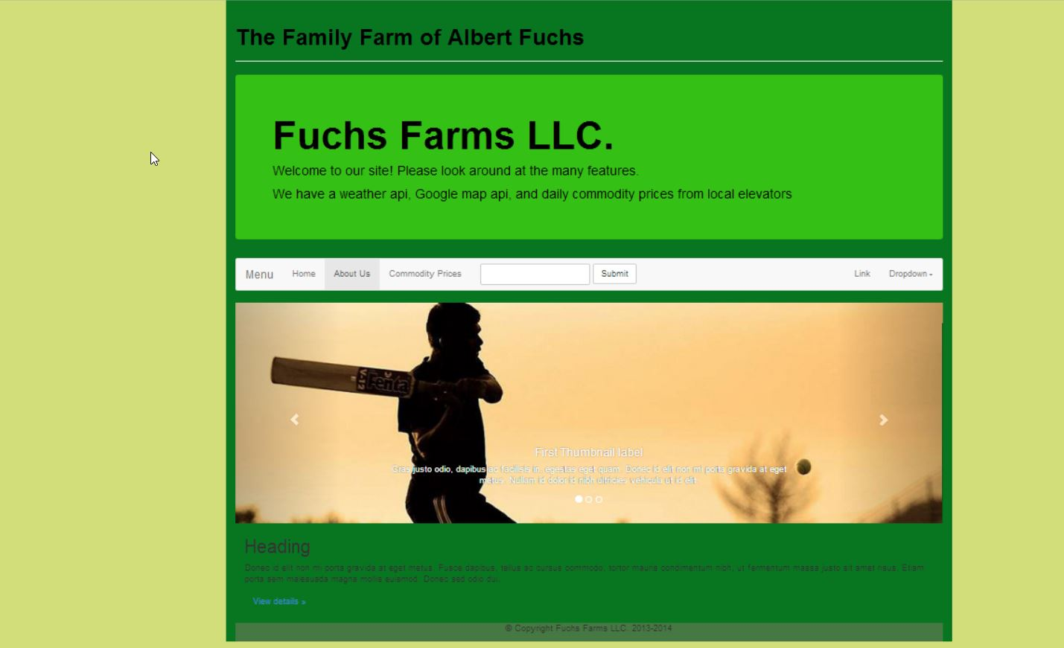
Our Goals
Utilize Google Maps to enhance page
Present Weather Underground Webservice allowing access for local farmers as a one stop shop
Learn Screen Scraping with PHP to pull commodity data from the Illinois Farm Bureau, Growers-Edge or other similar sites.
Local Farm News Webservice
Other Farm related webservices as time permits

Slide 4
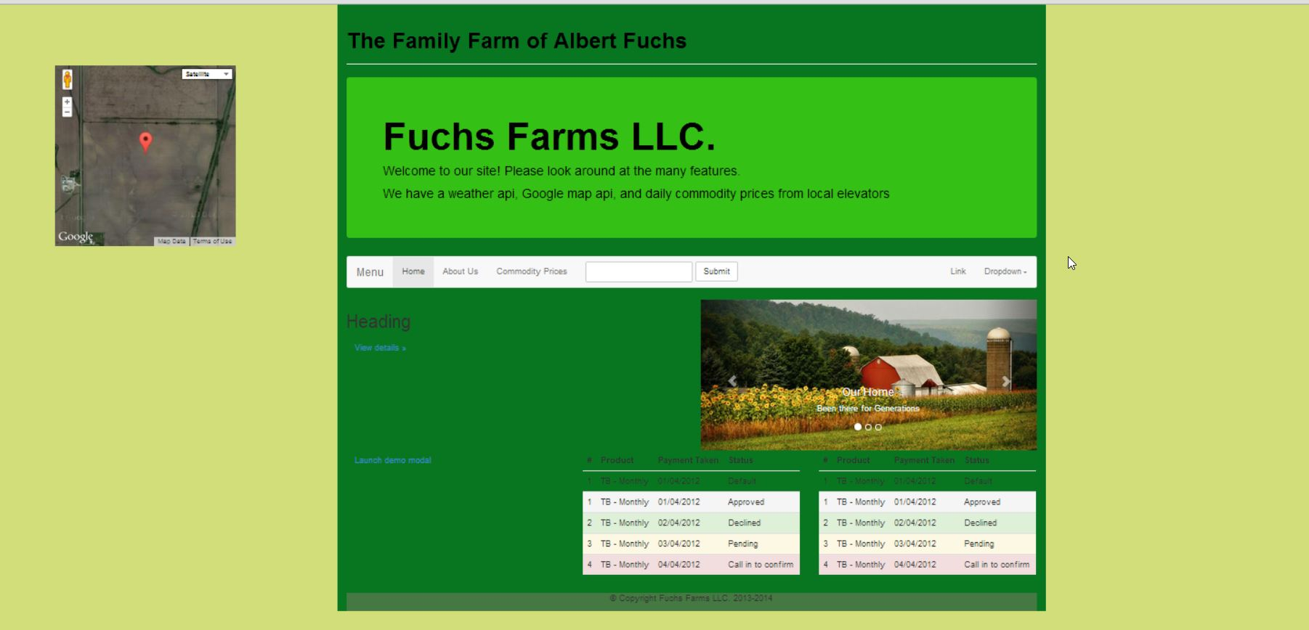
Home Page
Google Maps
W/ Satellite
Pinpointed on Farm

Slide 5
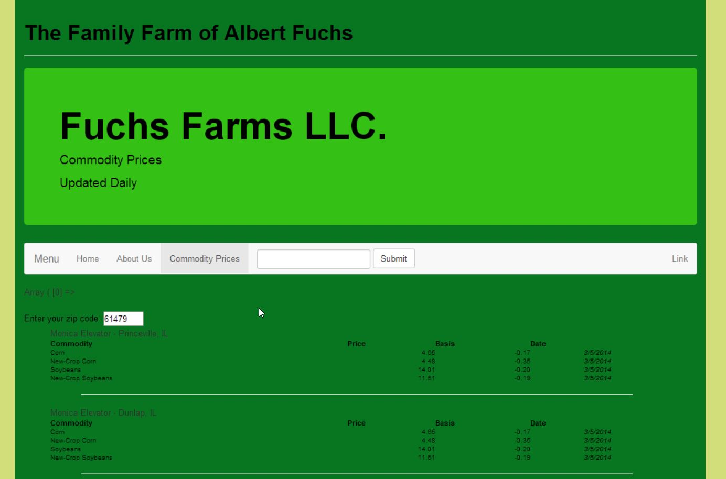
Commodity Prices Page
Screen Scraper to pull data from Illinois Farm Bureau Central or other cooperative sites- Illinois Prices

Slide 6
Questions
?

